Slide 1





Assignment 2 portfolio task 2 - Attack
By:
Krishan Himesh Abeyrathne Tennakoon Mudiyanselage - 12217274
and
Carl -
12123123123
GitHub Repository:
https://github.com/KrishanHimesh/COIT11241-Asignment-2-ePortforlio-Krishan-and-Carl.git

Slide 2



01
Search the Information System using Nessus , Nmap and Legion for vulnerabilities

Slide 3
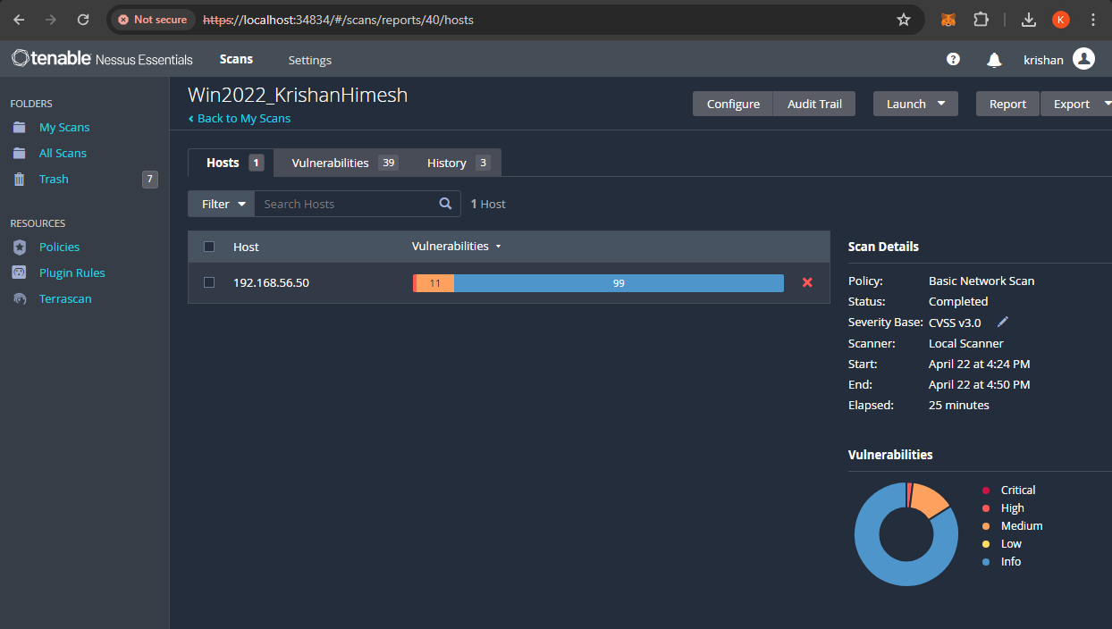
1. Nessus Scan of the Information system for vulnerabilities
The screenshot shows the vulnerability scan result of the Nessus of the Information System.
The complete vulnerability test result is shared in the GitHub repository Task 2 -Attack directory. Click this to access the repository

Slide 4
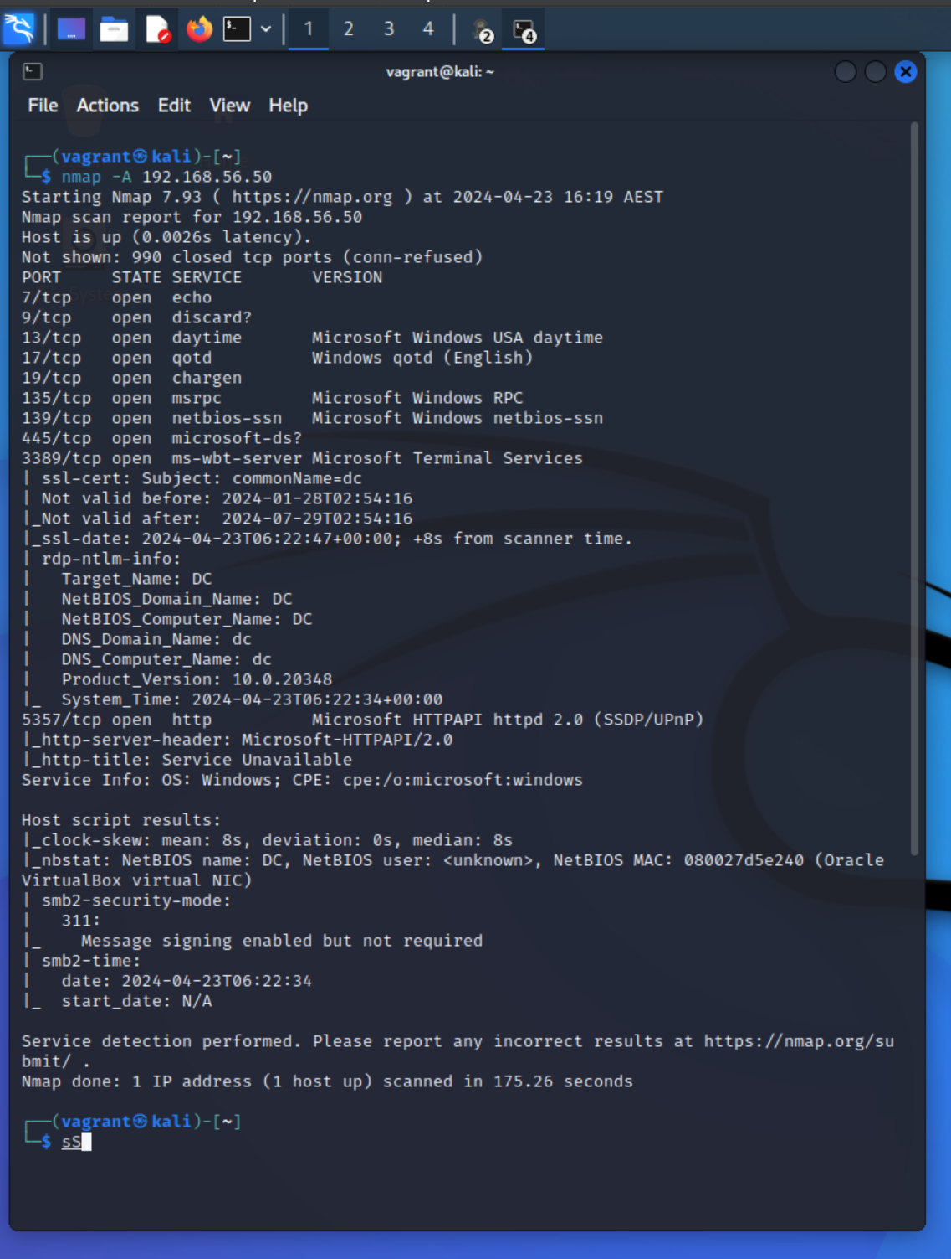
2. Using Nmap to check the Open ports
The screenshot shows the search of Nmap from Kali machine to check the open ports in the Information System, 192.168.56.50

Slide 5
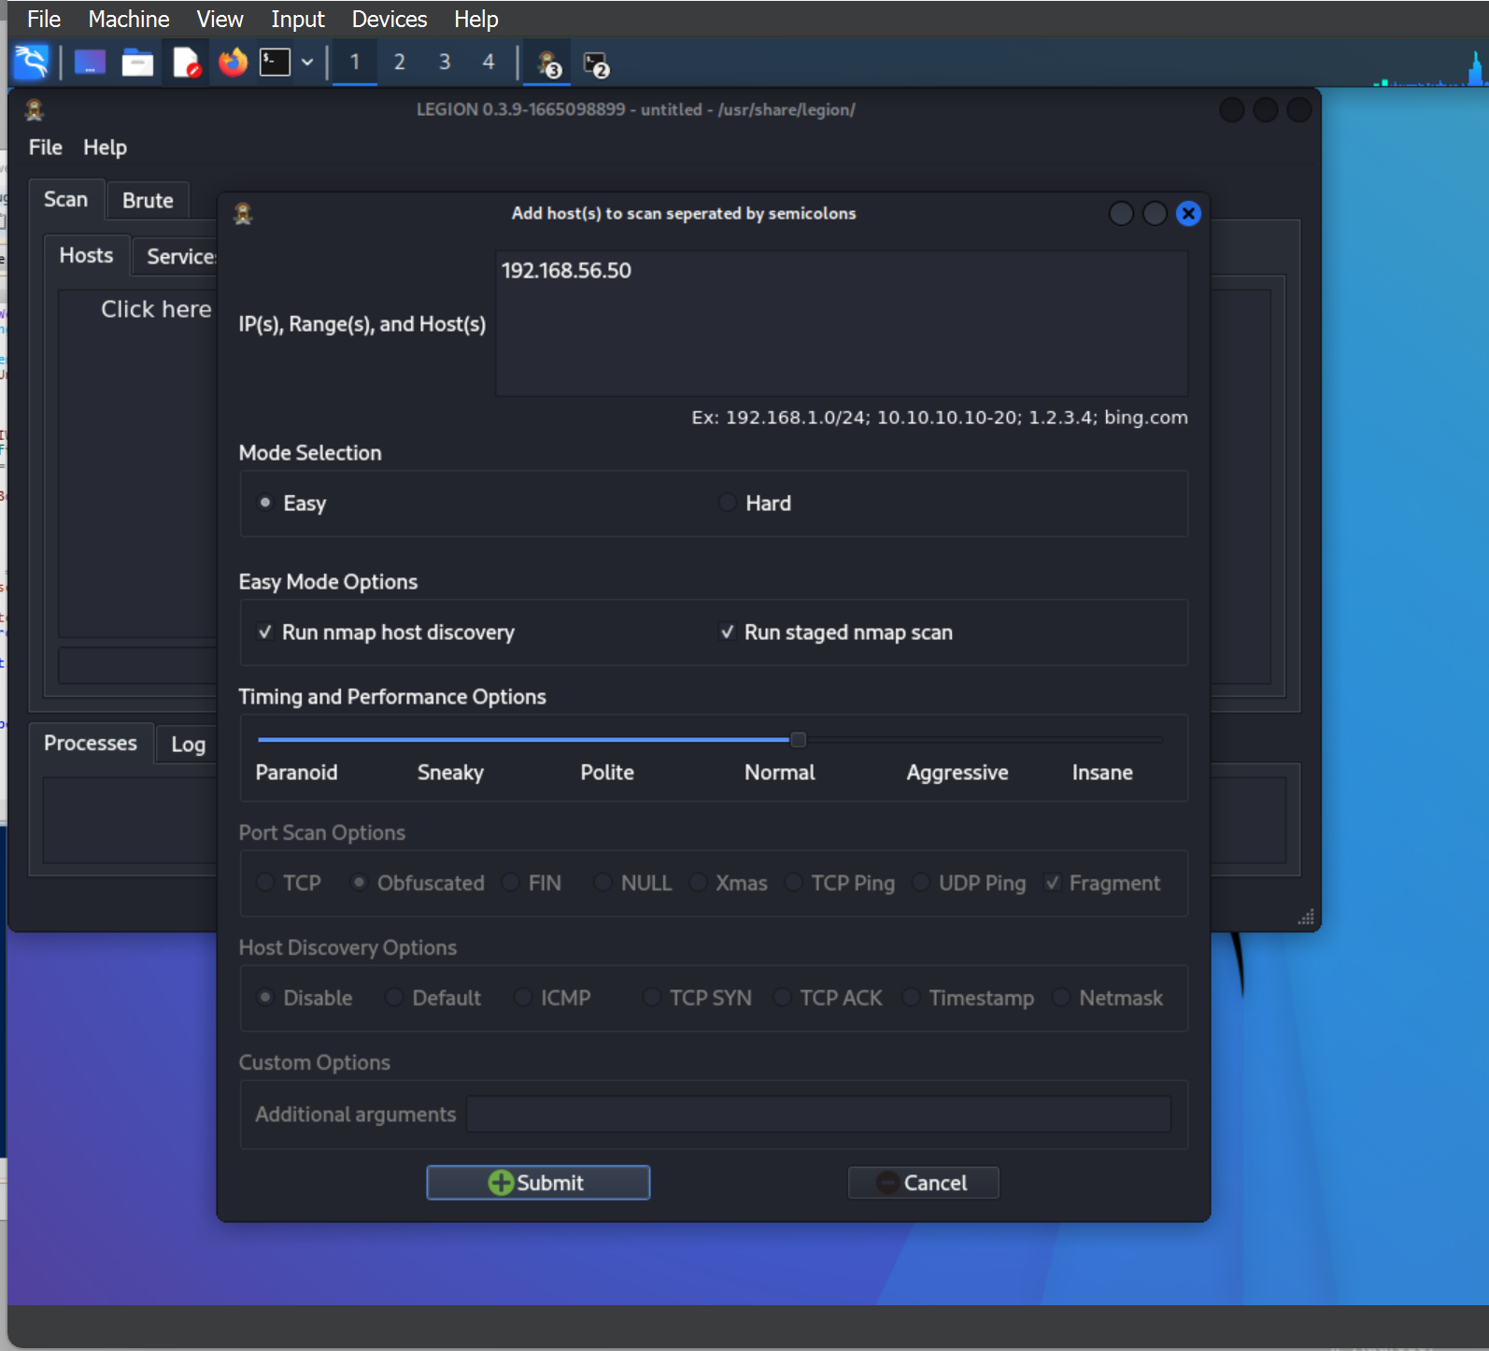
3. Using legion to check vulnerabilities of the information system
The screenshot shows the initiation of the Legion Vulnerability check. We have added the IP address of the information System, 192.168.56.50

Slide 6
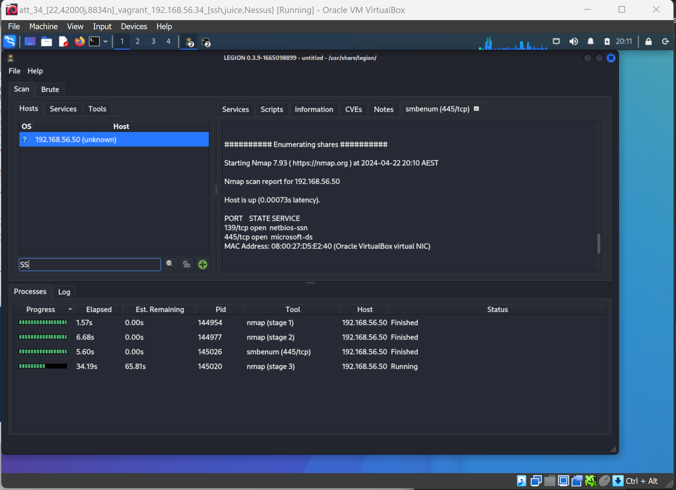

Slide 7
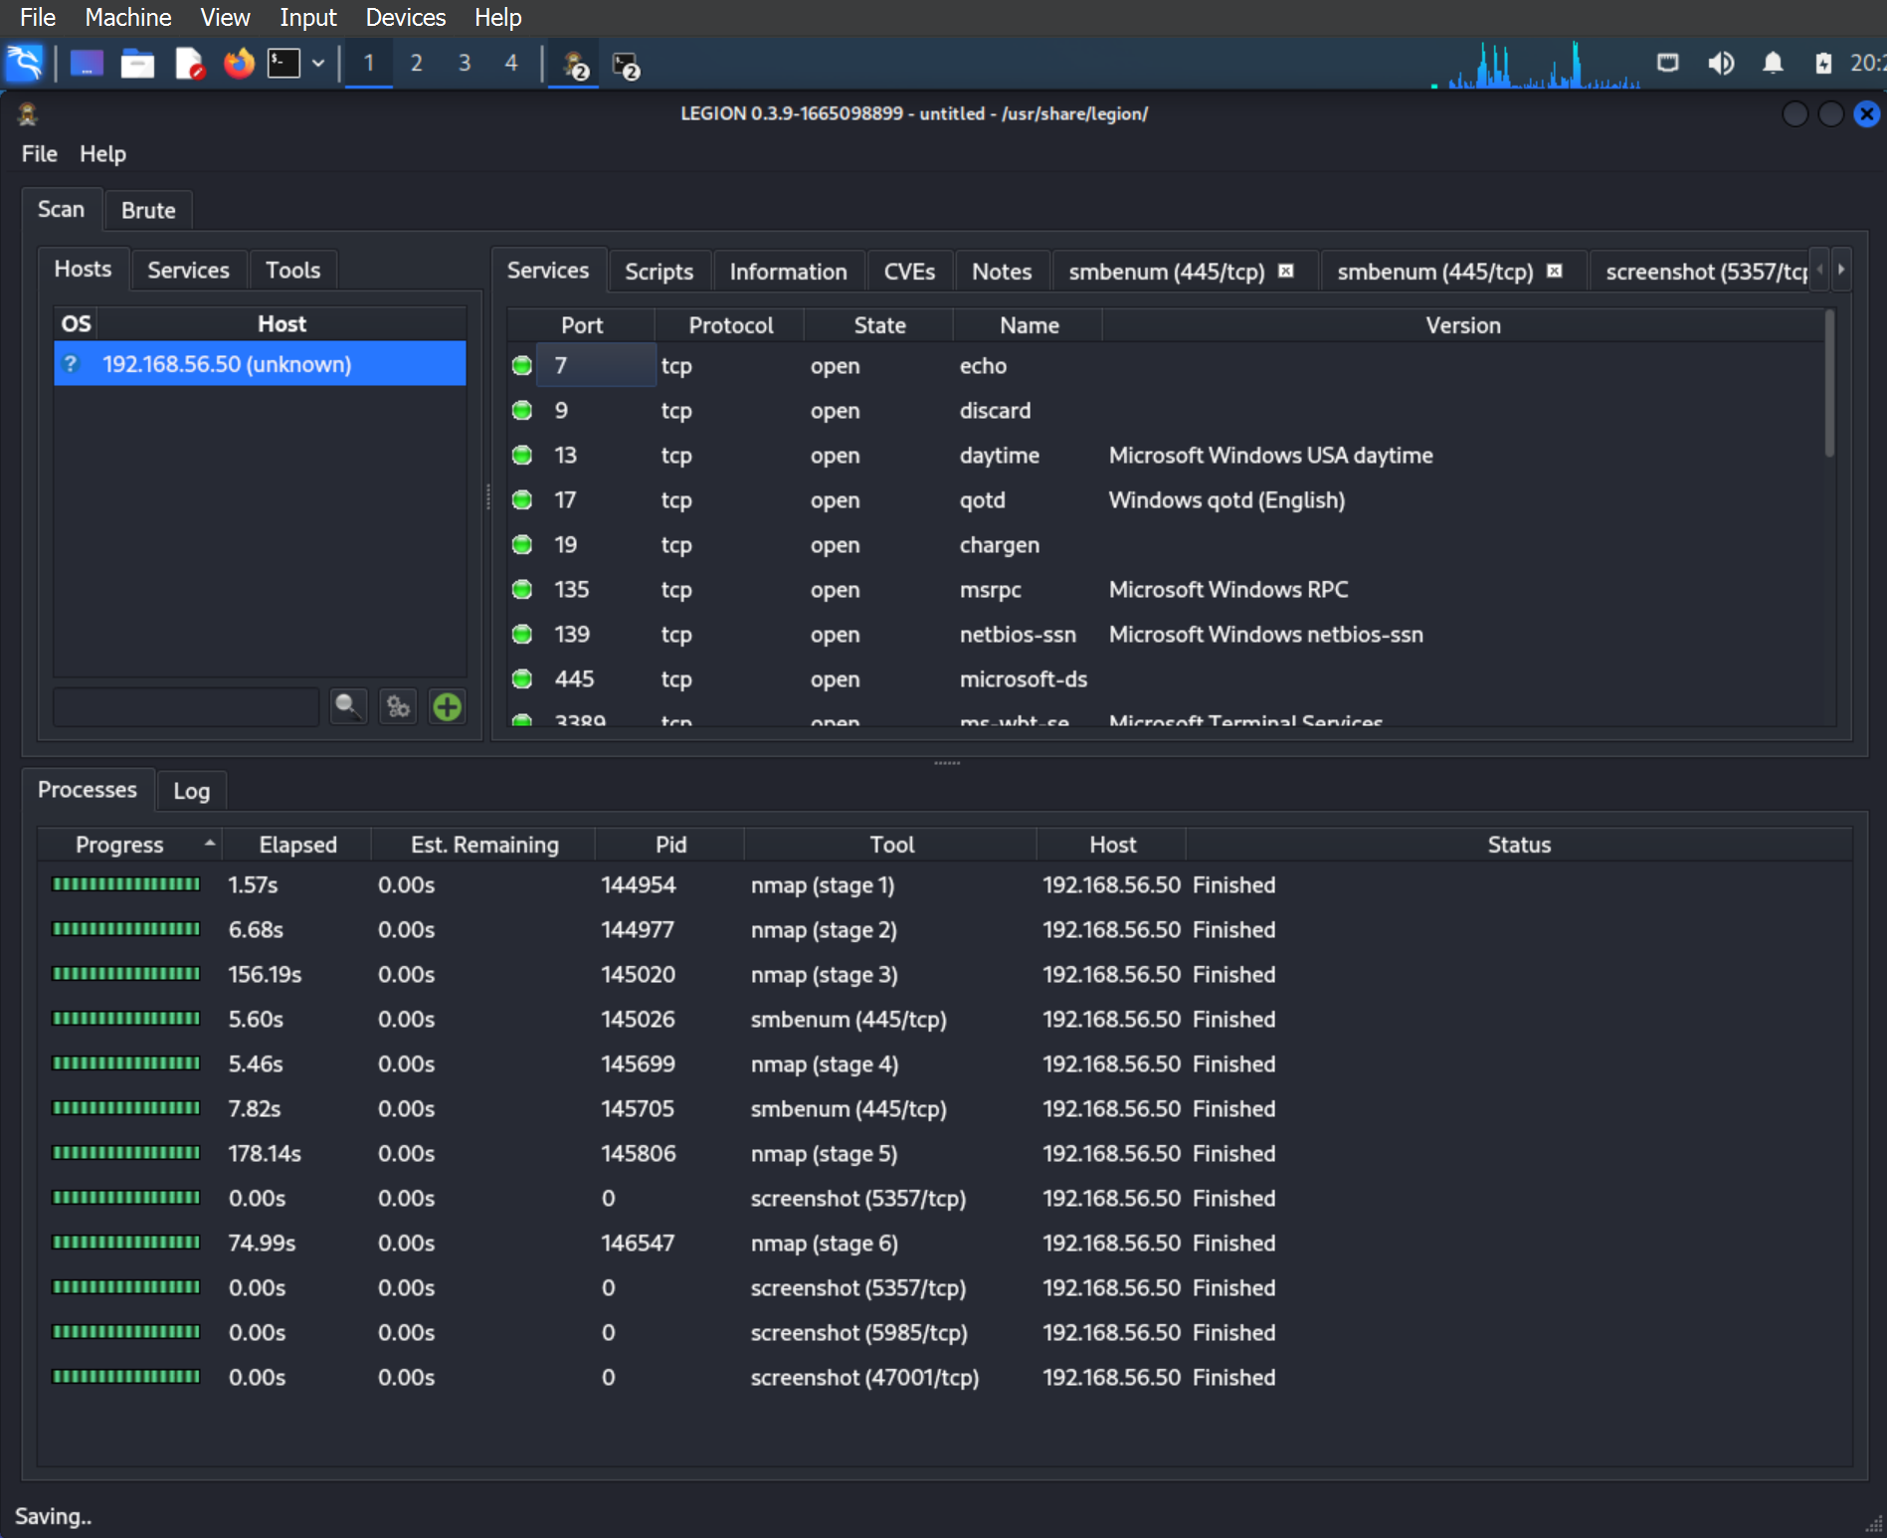

Slide 8
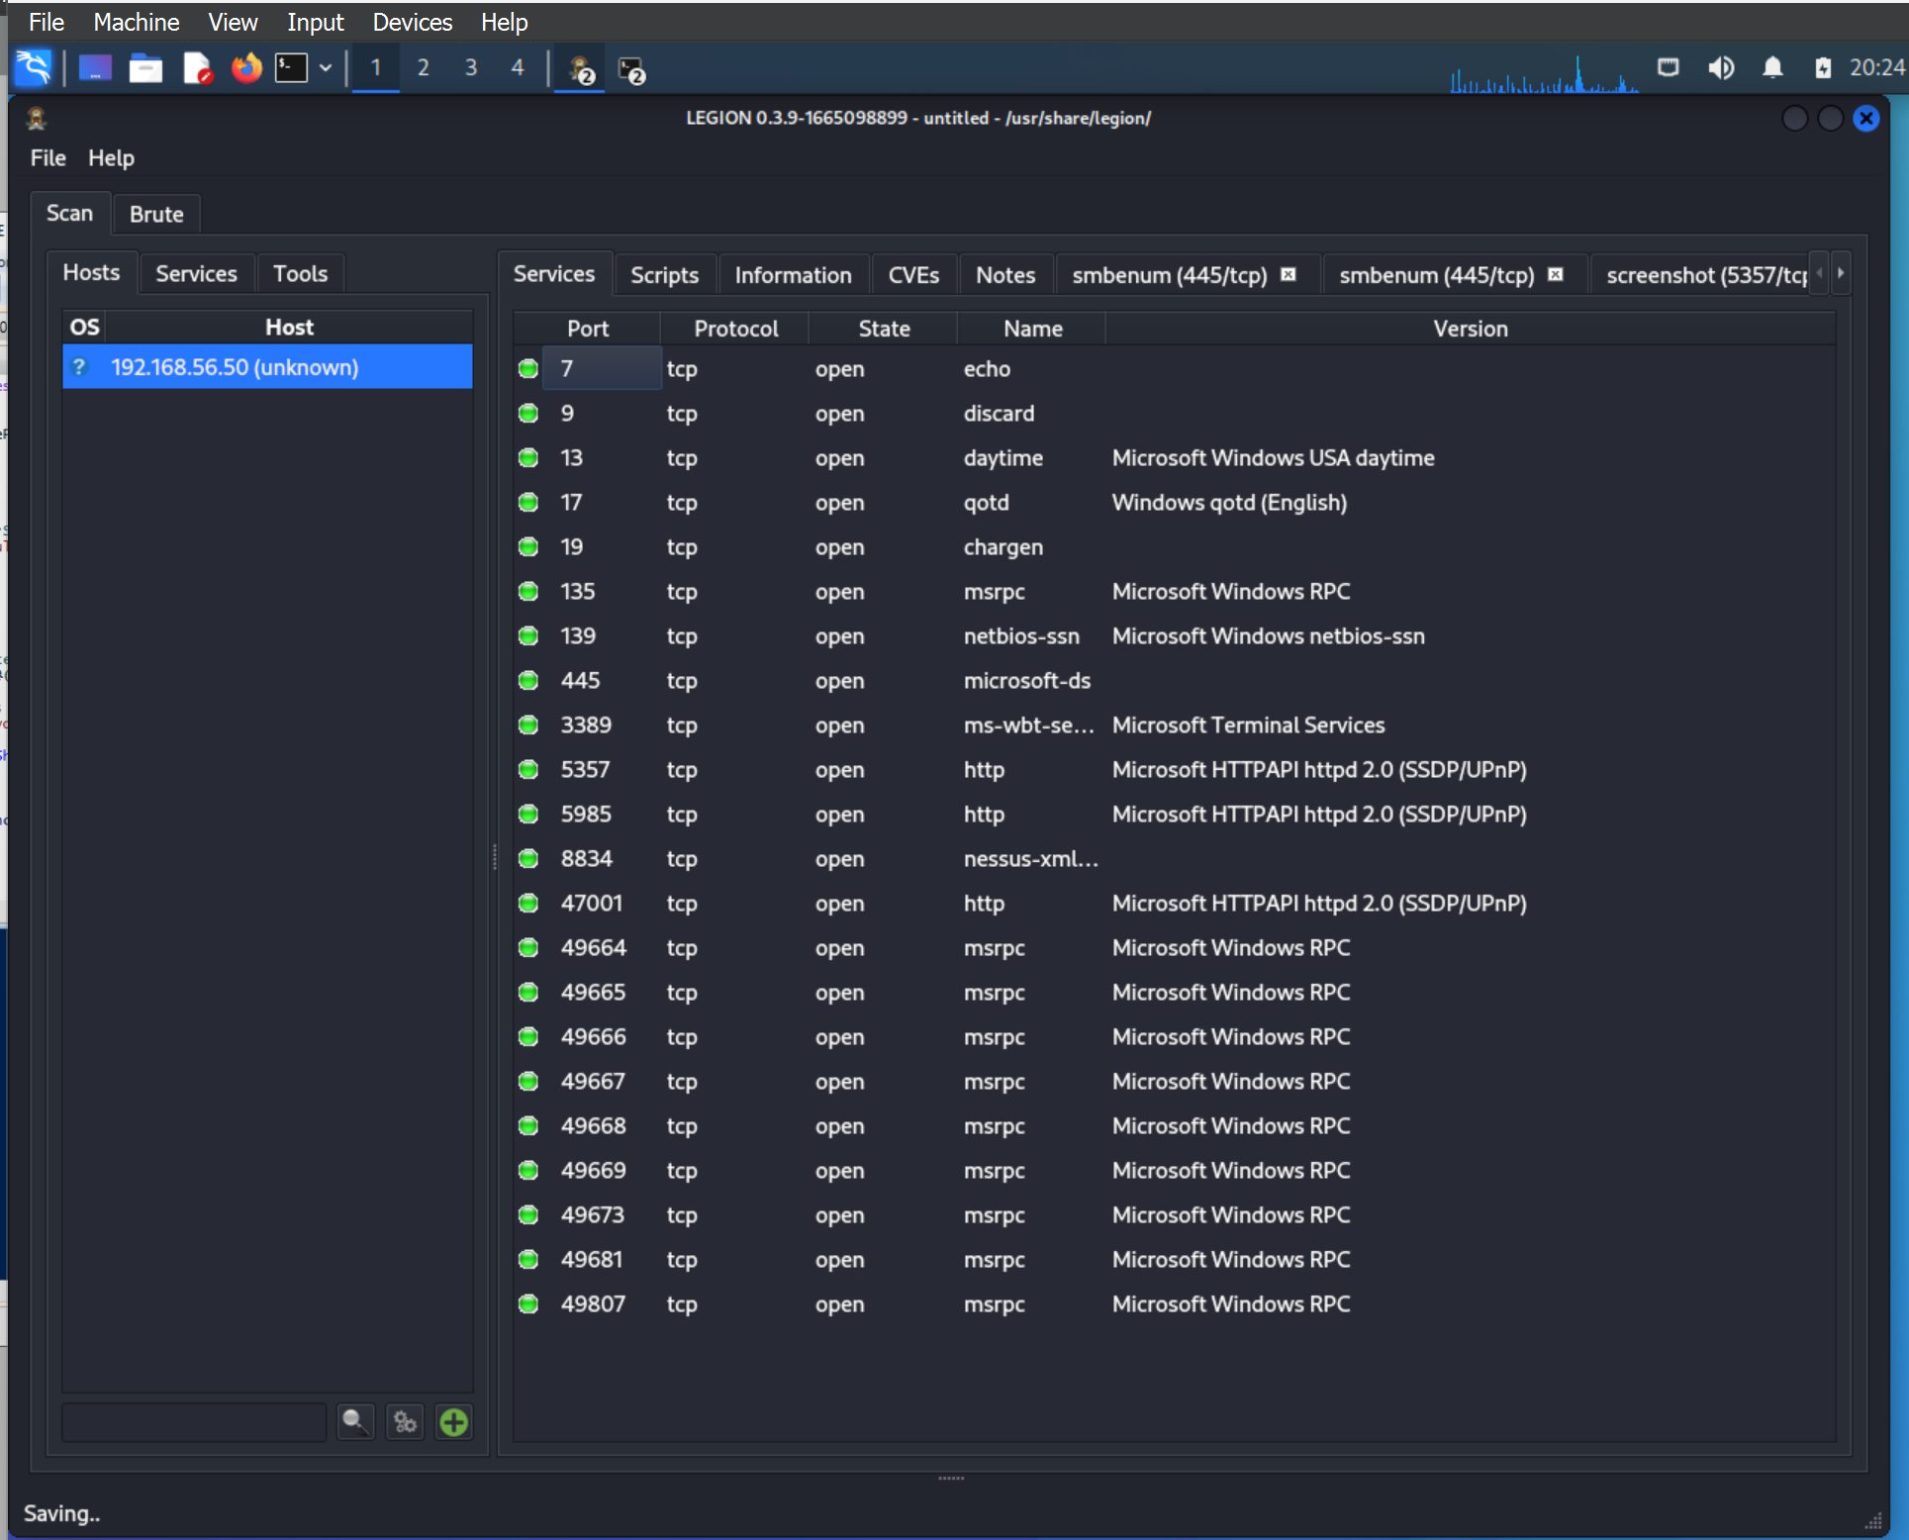

Slide 9
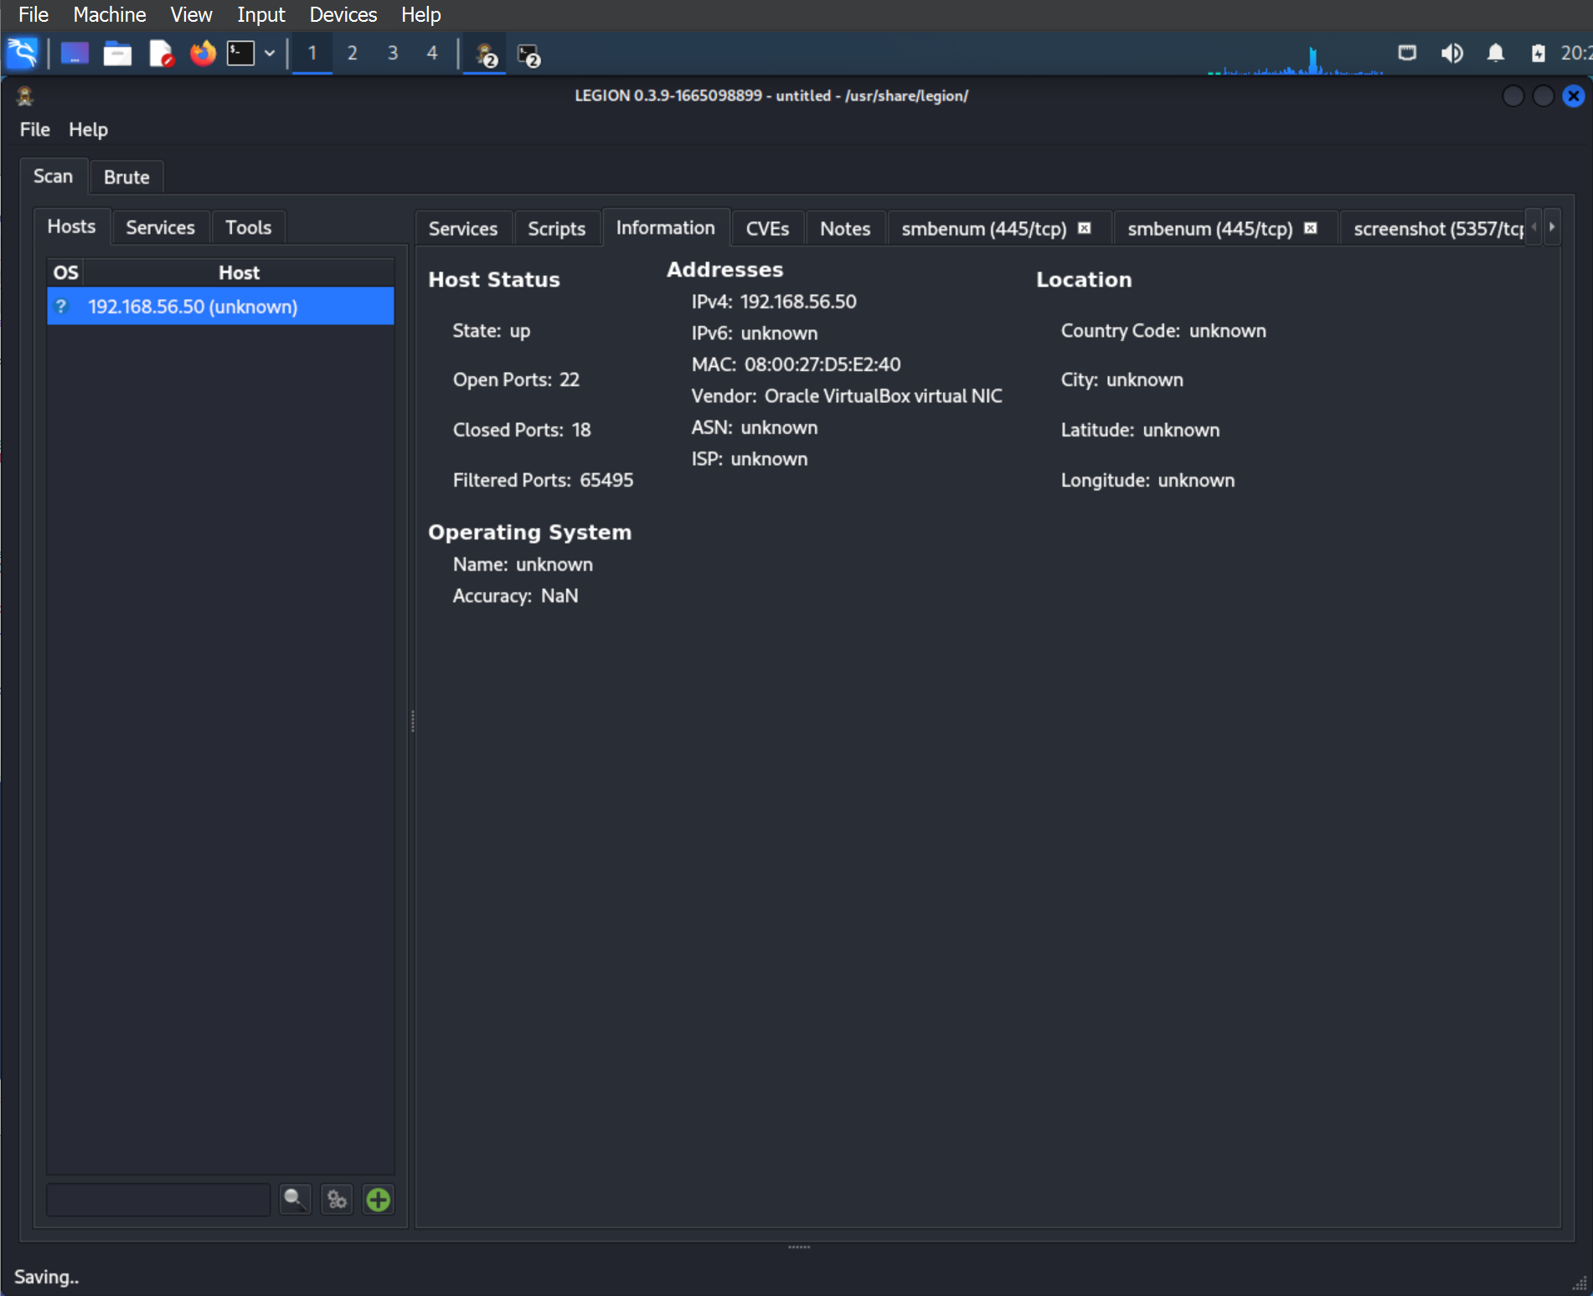

Slide 10
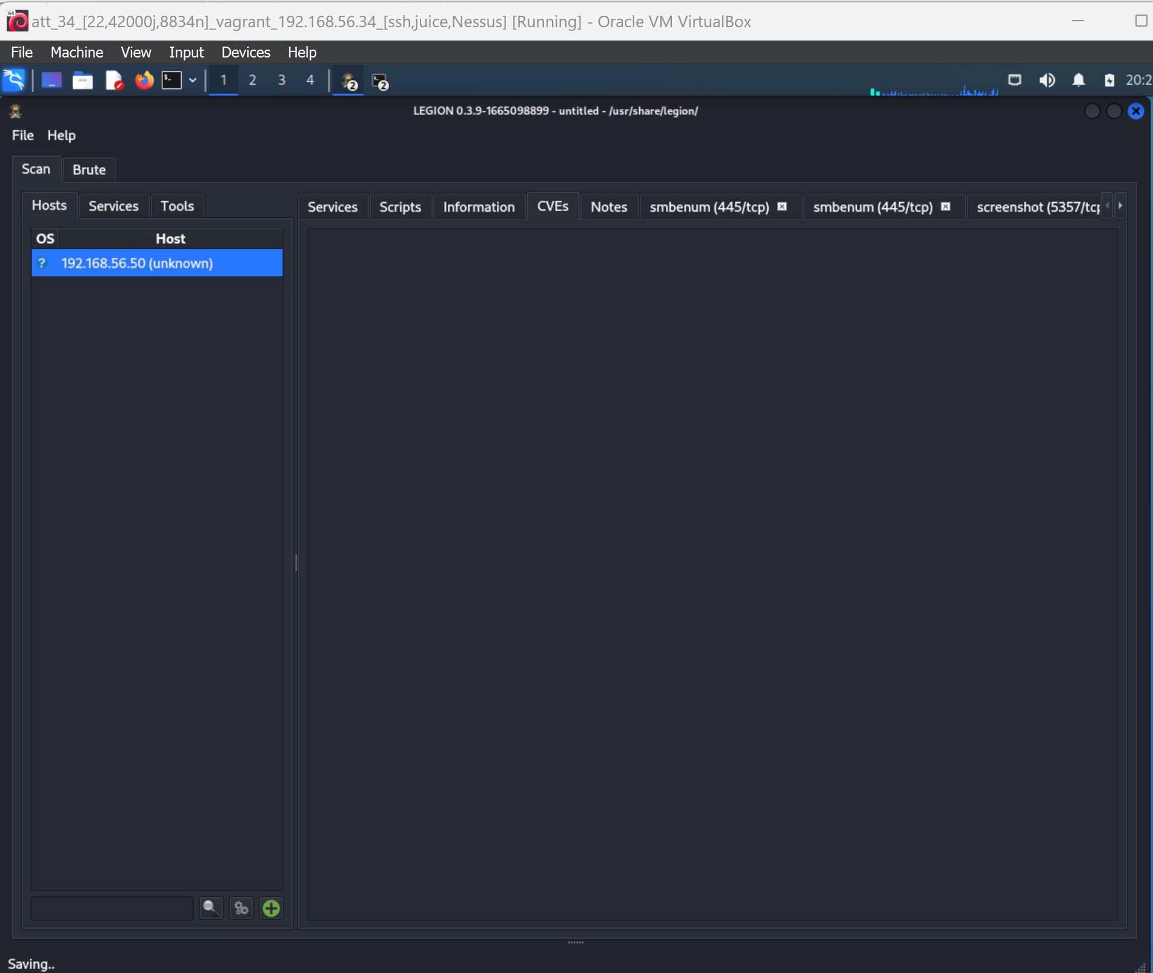

Slide 11

02
ATT&CK Threat Intelligence Report Medusa Group

Slide 12
Purpose and goal of this report
Providing organizations with actionable insights to enhance their cybersecurity defenses. By analyzing the group's tactics, techniques, and procedures mapped to the MITRE ATT&CK framework, This report aims to help organizations understand the threat landscape, mitigate risks, prepare for incident response, foster threat intelligence sharing, inform strategic decision-making, and serve as an educational resource for cybersecurity professionals. Ultimately, the report aims to empower organizations to better protect themselves against Medusa Group attacks and contribute to the collective cybersecurity resilience of the broader community.

Slide 13
ATT&CK Threat Intelligence Report
Group Name: Medusa Group
Associated Groups: None
Description:
Medusa Group is a cybercrime organization that has been active since at least 2019, primarily focused on deploying the MedusaLocker ransomware across various industries, including healthcare, education, and local government. The group is notorious for encrypting data and demanding ransom payments to provide decryption keys.

Slide 14
Techniques:
Data Encrypted for Impact (T1486) - MedusaLocker encrypts a wide range of file types, using AES and RSA algorithms, to disrupt operations and create urgency for ransom payments.

Slide 15
References: MITRE ATT&CK
Inhibit System Recovery (T1490) - The ransomware stops critical system services and deletes shadow copies to make data recovery without a ransom payment difficult or impossible.
References: CISA Alert AA20-266A
Valid Accounts (T1078) - Medusa Group uses stolen or compromised accounts to gain access to networks, allowing for lateral movement and persistence.
References: MITRE ATT&CK
Phishing: Spearphishing Attachment (T1566.001) - The group often uses spearphishing emails with malicious attachments to distribute MedusaLocker or steal valid account credentials.
References: Microsoft Security Intelligence
Remote Desktop Protocol (RDP) (T1021.001) - Medusa Group often gains initial access through unsecured RDP or compromised RDP credentials.
References: CISA Alert AA21-013A
Software Name: MedusaLocker

Slide 16
Description:
MedusaLocker is ransomware used by Medusa Group to encrypt data on victim systems and demand ransom payments. It is known for spreading across networks, stopping critical services, deleting backup data, and ensuring persistence to maximize its impact.
Techniques:
Boot or Logon Autostart Execution: Registry Run Keys / Startup Folder (T1547.001) - MedusaLocker adds entries to the Windows Registry to ensure execution every time the system restarts, allowing the ransomware to persist on victim systems.
References: MITRE ATT&CK

Slide 17
Service Stop (T1489) - MedusaLocker stops Windows services related to backups, anti-virus, and system recovery, preventing mitigation and ensuring a successful attack.
References: MITRE ATT&CK
Rationale for Sub/Techniques Selection:
The chosen techniques reflect the critical components of Medusa Group's modus operandi. Each technique plays a crucial role in the attack lifecycle, from gaining initial access and establishing persistence to executing the ransomware and inhibiting recovery efforts. The use of spearphishing, RDP, and valid accounts provides multiple entry points, while service stops and boot autostart ensure MedusaLocker operates without interference. These combined techniques maximize the impact of the ransomware attack, leading to successful ransom payments and significant financial gains for the group.

Slide 18
References:
Dark Web Profile: Medusa Ransomware (MedusaLocker) - SOCRadar® Cyber Intelligence Inc. Techniques - Enterprise | MITRE ATT&CK®
Medusa Ransomware Turning Your Files into Stone (paloaltonetworks.com)

Slide 19
Priorities of vulnerabilities found based on their likelihood of exploitation by the Threat Actor

Slide 20
PURPOSE AND GOAL of this report:

Slide 21
CVE 1:
CWE | CAPEC | ATT&CK | Used by Medusa
Rationale: Action:

Slide 22
CVE 2:
CWE | CAPEC | ATT&CK | Used by Medusa
Rationale: Action:

Slide 23
CVE 3:
CWE | CAPEC | ATT&CK | Used by Medusa
Rationale: Action:

